Slide 1
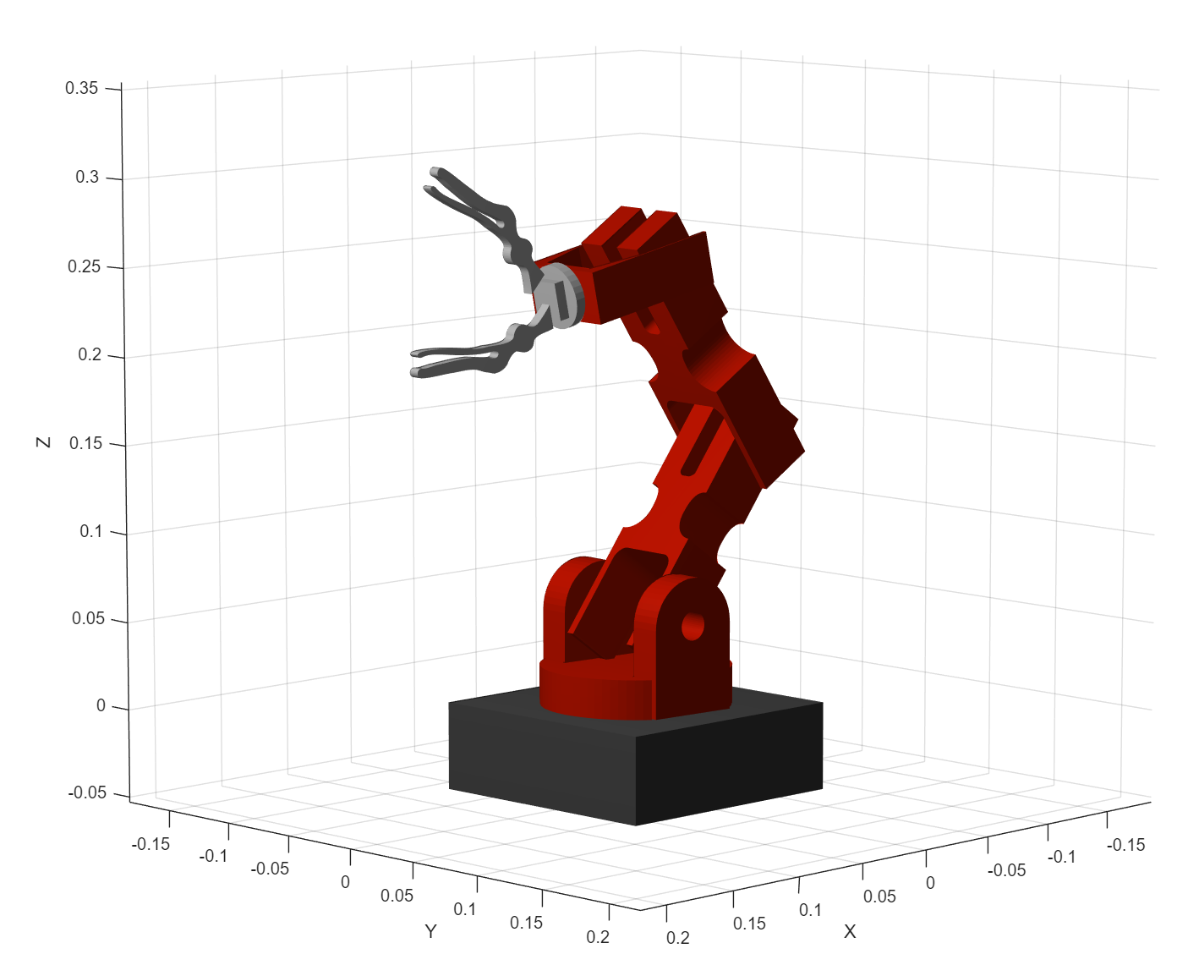
Robotic Arm System
Sensor Array System
On-Arm
Assembly
Encoders
Servos
(6DOF)
Early Warning
ToF
Sensors
Reactive
Command
IR
Sensors
θ
i_{θ}
PSU 9V_{DC}
L^{8x8}
Motor Drives
θ_{m}
Host PC
I2C MUX
λ_{i}
Sensor Signal Processing
u_{N}
L_{k}
5V_{DC}
Teensy 4.1
Powerful microprocessor handling:
- Generation of PWM (u_{N}) for N motor drives
- Data Acquisiton of encoder angles (θ_{m} ) for control system feedback
Control System
Arduino MEGA
Extended I/O to handle I2C bus from analog ToF sensor outputs (L_{k}) and digital logic from IR sensors (λ_{i}) to use for disturbance or obstacle modeling in the host PC
Trajectory Optimization

Slide 2

Robotic Arm System
Sensor Array System
5V_{DC}
Early Warning
ToF
Sensors
9V_{DC}
I2C MUX
Position Feedback
Servo Driver
IR “Skin”
Sensors
θ
i_{θ}
L_{k}
θ_{m}
u_{N}
λ_{i}
Arduino UNO Q
Powerful microprocessor handling:
- Generation of PWM (u_{N}) for N motor drives
- Data Acquisiton of encoder angles (θ_{m} ) for control system feedback
Host PC
Teensy 4.1
Extended I/O to handle I2C bus from analog ToF sensor outputs (L_{k}) and digital logic from IR sensors (λ_{i}) to use for disturbance or obstacle modeling in the host PC
Sensor Signal Processing
θ_{m}
Control System
u_{N}
Trajectory Optimization

